Slide 1
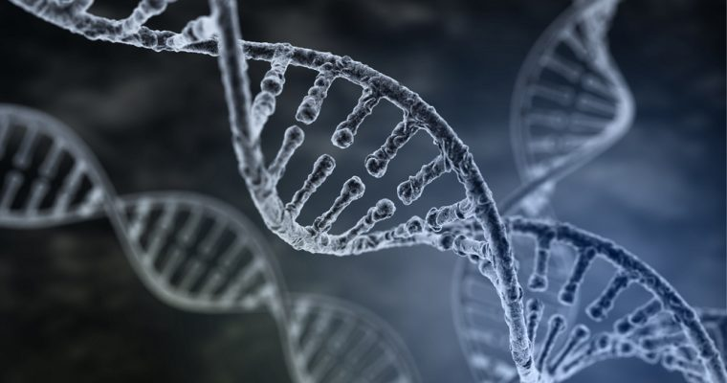
DNA Computing
In detail

Slide 2
Key Terms
DNA - A molecule that is made up of two long chains that are bonded together in the form of a double helix by the bonds that exist between 4 types of bases known as Adenine (A), Thymine (T), Guanine (G) and Cytosine (C). These bonds are known as Watson-Crick Pairs.
Watson-Crick Pairs - Base A bonds with base T and base G bonds with base C
Enzymes - molecules that act as catalysts to speed up chemical reactions in the body
Polymerase - An enzyme which moves along a strand of DNA reading the base and creating a complementary strand. That is to say, if it reads the strand of DNA that is ACAGT, it will create a new strand that is its complement, TGTCA.

Slide 3
Key Terms
Primer - A primer can be considered to be a short strand of DNA that, when seen by Polymerase, tells it to start creating a complementary strand.
Ligases - An enzyme which joins strands of DNA together to make a longer strand.
Nucleases - Nucleases will search a strand of DNA looking for a specific sequence of Watson-Crick pairs. When it finds this, it cuts the DNA strand creating two strands.
Gel Electrophoresis - This is a technique that we can use to separate strands of DNA based on their length. Basically, an electrical current is applied to a gel that contains the DNA Strands. DNA is charged and so each strand moves towards the Anode attached to the gel but the shorter strands can move a lot faster and so you get a separation of the strands by length.

Slide 4
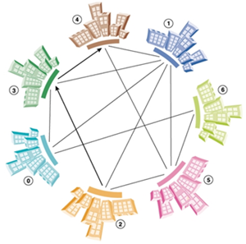
What problem was solved?
Adleman used DNA to compute a solution to the travelling salesman problem. That is, he found a path that started and ended at a specific city and that visited every other city exactly once.
The number of cities that Adleman solved this problem for was 7.

Slide 5
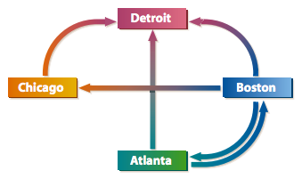
How did he represent the problem?
Consider the smaller version of the problem shown on the right.
Adleman came up with a specific sequence of bases that were a code for each city.
Atlanta = ACTTGCAG
Boston = TCGGACTG
Chicago = GGCTATGT
Detroit = CCGAGCAA

Slide 6
How did he represent the problem?
He then represented each pathway by combining the last 4 digits of the start node with the first 4 digits of the end node.
Thus:
Atlanta ➡️ Detroit = GCAGCCGA
Boston ➡️ Chicago = ACTGGGCT
Boston ➡️ Detroit = ACTGCCGA
Boston ➡️ Atlanta = ACTGACTT
Chicago ➡️ Detroit = ATGTCCGA
Atlanta ➡️ Boston = GCAGTCGG
Atlanta = ACTTGCAG
Boston = TCGGACTG
Chicago = GGCTATGT
Detroit = CCGAGCAA

Slide 7
How did he represent the problem?
Next he sent the pathways and the complements of each city’s code to be synthesised (created).
Thus he ended up with a vial of: and a vial of:
Atlanta ➡️ Detroit = GCAGCCGA
Boston ➡️ Chicago = ACTGGGCT
Boston ➡️ Detroit = ACTGCCGA
Boston ➡️ Atlanta = ACTGACTT
Chicago ➡️ Detroit = ATGTCCGA
Atlanta ➡️ Boston = GCAGTCGG
Atlanta‘ = TGAACGTC
Boston‘ = AGCCTGAC
Chicago’ = CCGATACA
Detroit’ = GGCTCGTT

Slide 8
Mixing
When these two vials were added together and mixed (along with water and ligase to allow the strands to join together) the strands were joined together as shown below.
Only strands that contained valid connecting city codes would join because of the complementary strands in the mixture.
TGAACGTC
AGCCTGAC
GCAGTCGG
ACTGCCGA

Slide 9
Weeding out the solution
As the mixture now contains a whole lot of possible solutions, each with various lengths of DNA chains, it is now important to isolate those that are valid solutions.
Adleman used Polymerase to duplicate the strands of DNA that started and ended at the right cities. The primers for the Polymerase used was thus GCAG and GGCT which allowed for strands with these cities at the end to be copied.
This results in the sample now containing a lot of copies of the correct solution but fewer of the incorrect solutions.

Slide 10
Weeding out the solution
As the mixture now contains a whole lot of possible solutions, each with various lengths of DNA chains, it is now important to isolate those that are valid solutions.
Adleman used Polymerase to duplicate the strands of DNA that started and ended at the right cities. The primers for the Polymerase used was thus GCAG and GGCT which allowed for strands with these cities at the end to be copied.
This results in the sample now containing a lot of copies of the correct solution but fewer of the incorrect solutions.

Slide 11
Gel Electrophoresis and Iron Balls
Now the strands were put through the process of gel electrophoresis in order to isolate those that were of the length that contained exactly the number of cities that needed to be visited (4 for our example).
Then he used a technique known as Affinity Separation which allowed him to attach microscopic iron balls to a strand of DNA representing a specific city. By adding in the iron balls for say Boston, and then using a magnet, he could tip out all of the DNA strands that didn’t contain Boston, keeping those that did. Then adding in Atlanta and repeating for each city in turn, the remaining DNA Strands will contain only those paths that have each city in them.
By reading the remaining strands of DNA, the solution was found.

Slide 12
So What is DNA Computing?
Basically, it is just massive parallel processing.
When you shake the mixture up, you are generating (probably) all possible combinations or ways in which the strands can join together and so all that is required is to then find the relevant solution.
This works well for small samples but doesn’t scale particularly well. In fact, the size of the sample of DNA needed as the input size of the problem grows tends to be exponential in size and to solve a problem with 10,000 cities would require a volume of DNA that is greater than the volume of The Sun.

Slide 13
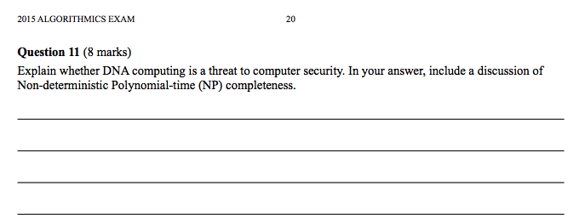
That VCAA Question

Slide 14
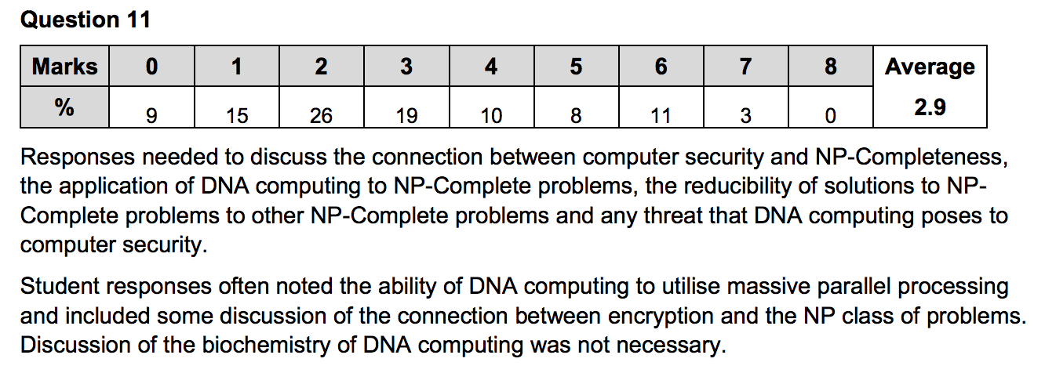
That VCAA Question

